Slide 1
Analysis of a USB storage device
FAT Analysis

Slide 2
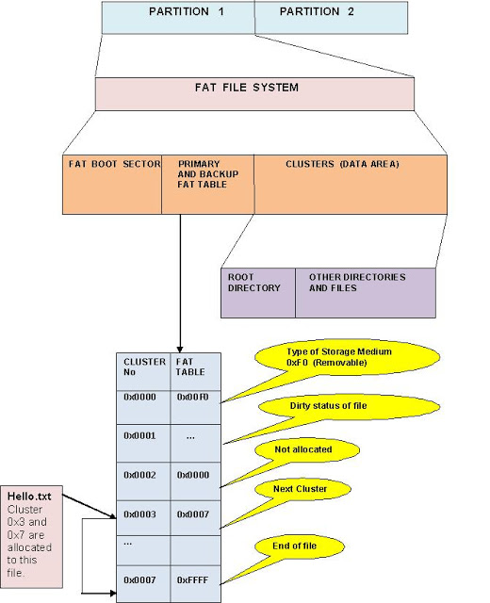
FAT File System Layout on disk

Slide 3
The disk format
Boot sector (1 sector) | FAT #1 (one+ sectors) | FAT #2 (one+ sectors) | Root directory (FAT12/16 only) | Data region (rest of disk)
Boot section
It holds a special program (the bootstrap program)
bootstrap program: is used for loading the operating system into memory.
FAT
a method of keeping track of the contents of a hard drive
used by early Microsoft operating systems
was first introduced in 1977.
Root Directory
contains an entry for each file whose name appears at the root (the top level) of the file system.

Slide 4
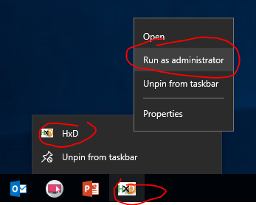
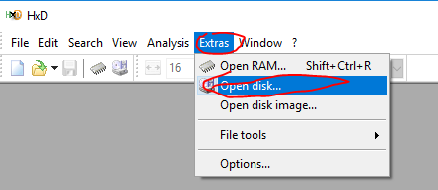
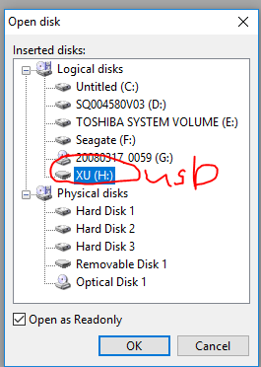
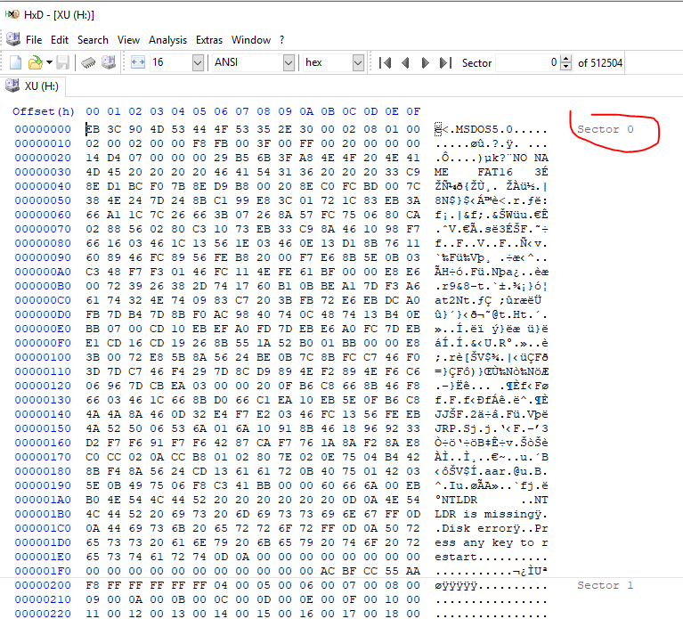
Use HxD to open a USB

Slide 5
Boot sector
Occupies just the first block of the disk.
Contains several important data areas
help to describe the rest of the file system.

Slide 6
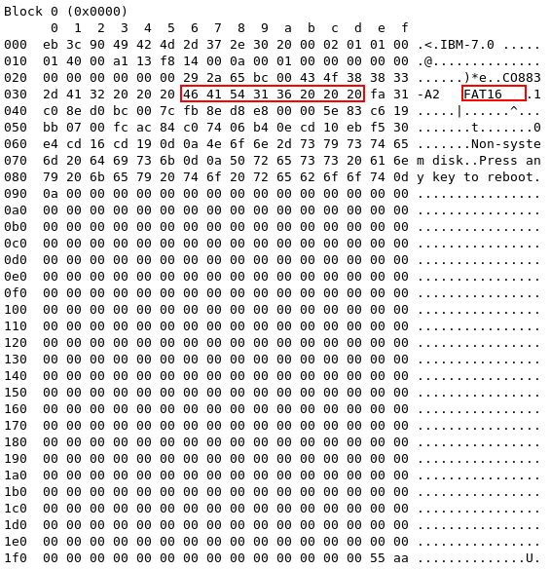
Example 1: Find file system type: FAT 16
Offset | Length | Description
0x00 | 3 bytes | Part of the bootstrap program.
0x03 | 8 bytes | Optional manufacturer description.
0x0b | 2 bytes | Number of bytes per block (almost always 512).
0x0d | 1 byte | Number of blocks per allocation unit.
0x0e | 2 bytes | Number of reserved blocks. This is the number of blocks on the disk that are not actually part of the file system; in most cases this is exactly 1, being the allowance for the boot block.
0x10 | 1 byte | Number of File Allocation Tables.
0x11 | 2 bytes | Number of root directory entries (including unused ones).
0x13 | 2 bytes | Total number of blocks in the entire disk. If the disk size is larger than 65535 blocks (and thus will not fit in these two bytes), this value is set to zero, and the true size is stored at offset 0x20.
0x15 | 1 byte | Media Descriptor. This is rarely used, but still exists. .
0x16 | 2 bytes | The number of blocks occupied by one copy of the File Allocation Table.
0x18 | 2 bytes | The number of blocks per track. This information is present primarily for the use of the bootstrap program, and need not concern us further here.
0x1a | 2 bytes | The number of heads (disk surfaces). This information is present primarily for the use of the bootstrap program, and need not concern us further here.
0x1c | 4 bytes | The number of hidden blocks. The use of this is largely historical, and it is nearly always set to 0; thus it can be ignored.
0x20 | 4 bytes | Total number of blocks in the entire disk (see also offset 0x13).
0x24 | 2 bytes | Physical drive number. This information is present primarily for the use of the bootstrap program, and need not concern us further here.
0x26 | 1 byte | Extended Boot Record Signature This information is present primarily for the use of the bootstrap program, and need not concern us further here.
0x27 | 4 bytes | Volume Serial Number. Unique number used for identification of a particular disk.
0x2b | 11 bytes | Volume Label. This is a string of characters for human-readable identification of the disk (padded with spaces if shorter); it is selected when the disk is formatted.
0x36 | 8 bytes | File system identifier (padded at the end with spaces if shorter).
0x3e | 0x1c0 bytes | The remainder of the bootstrap program.
0x1fe | 2 bytes | Boot block 'signature' (0x55 followed by 0xaa).
Notes:
16*64=1024 means root directory has two sectors.

Slide 7
Example 2
Offset | Length | Description
0x00 | 3 bytes | Part of the bootstrap program.
0x03 | 8 bytes | Optional manufacturer description.
0x0b | 2 bytes | Number of bytes per block (almost always 512).
0x0d | 1 byte | Number of blocks per allocation unit.
0x0e | 2 bytes | Number of reserved blocks. This is the number of blocks on the disk that are not actually part of the file system; in most cases this is exactly 1, being the allowance for the boot block.
0x10 | 1 byte | Number of File Allocation Tables.
0x11 | 2 bytes | Number of root directory entries (including unused ones).
0x13 | 2 bytes | Total number of blocks in the entire disk. If the disk size is larger than 65535 blocks (and thus will not fit in these two bytes), this value is set to zero, and the true size is stored at offset 0x20.
0x15 | 1 byte | Media Descriptor. This is rarely used, but still exists. .
0x16 | 2 bytes | The number of blocks occupied by one copy of the File Allocation Table.
0x18 | 2 bytes | The number of blocks per track. This information is present primarily for the use of the bootstrap program, and need not concern us further here.
0x1a | 2 bytes | The number of heads (disk surfaces). This information is present primarily for the use of the bootstrap program, and need not concern us further here.
0x1c | 4 bytes | The number of hidden blocks. The use of this is largely historical, and it is nearly always set to 0; thus it can be ignored.
0x20 | 4 bytes | Total number of blocks in the entire disk (see also offset 0x13).
0x24 | 2 bytes | Physical drive number. This information is present primarily for the use of the bootstrap program, and need not concern us further here.
0x26 | 1 byte | Extended Boot Record Signature This information is present primarily for the use of the bootstrap program, and need not concern us further here.
0x27 | 4 bytes | Volume Serial Number. Unique number used for identification of a particular disk.
0x2b | 11 bytes | Volume Label. This is a string of characters for human-readable identification of the disk (padded with spaces if shorter); it is selected when the disk is formatted.
0x36 | 8 bytes | File system identifier (padded at the end with spaces if shorter).
0x3e | 0x1c0 bytes | The remainder of the bootstrap program.
0x1fe | 2 bytes | Boot block 'signature' (0x55 followed by 0xaa).

Slide 8
Example 3: Sectors Per Cluster
Offset | Length | Description
0x00 | 3 bytes | Part of the bootstrap program.
0x03 | 8 bytes | Optional manufacturer description.
0x0b | 2 bytes | Number of bytes per block (almost always 512).
0x0d | 1 byte | Number of blocks per allocation unit.
0x0e | 2 bytes | Number of reserved blocks. This is the number of blocks on the disk that are not actually part of the file system; in most cases this is exactly 1, being the allowance for the boot block.
0x10 | 1 byte | Number of File Allocation Tables.
0x11 | 2 bytes | Number of root directory entries (including unused ones).
0x13 | 2 bytes | Total number of blocks in the entire disk. If the disk size is larger than 65535 blocks (and thus will not fit in these two bytes), this value is set to zero, and the true size is stored at offset 0x20.
0x15 | 1 byte | Media Descriptor. This is rarely used, but still exists. .
0x16 | 2 bytes | The number of blocks occupied by one copy of the File Allocation Table.
0x18 | 2 bytes | The number of blocks per track. This information is present primarily for the use of the bootstrap program, and need not concern us further here.
0x1a | 2 bytes | The number of heads (disk surfaces). This information is present primarily for the use of the bootstrap program, and need not concern us further here.
0x1c | 4 bytes | The number of hidden blocks. The use of this is largely historical, and it is nearly always set to 0; thus it can be ignored.
0x20 | 4 bytes | Total number of blocks in the entire disk (see also offset 0x13).
0x24 | 2 bytes | Physical drive number. This information is present primarily for the use of the bootstrap program, and need not concern us further here.
0x26 | 1 byte | Extended Boot Record Signature This information is present primarily for the use of the bootstrap program, and need not concern us further here.
0x27 | 4 bytes | Volume Serial Number. Unique number used for identification of a particular disk.
0x2b | 11 bytes | Volume Label. This is a string of characters for human-readable identification of the disk (padded with spaces if shorter); it is selected when the disk is formatted.
0x36 | 8 bytes | File system identifier (padded at the end with spaces if shorter).
0x3e | 0x1c0 bytes | The remainder of the bootstrap program.
0x1fe | 2 bytes | Boot block 'signature' (0x55 followed by 0xaa).

Slide 9
Example 4
Offset | Length | Description
0x00 | 3 bytes | Part of the bootstrap program.
0x03 | 8 bytes | Optional manufacturer description.
0x0b | 2 bytes | Number of bytes per block (almost always 512).
0x0d | 1 byte | Number of blocks per allocation unit.
0x0e | 2 bytes | Number of reserved blocks. This is the number of blocks on the disk that are not actually part of the file system; in most cases this is exactly 1, being the allowance for the boot block.
0x10 | 1 byte | Number of File Allocation Tables.
0x11 | 2 bytes | Number of root directory entries (including unused ones).
0x13 | 2 bytes | Total number of blocks in the entire disk. If the disk size is larger than 65535 blocks (and thus will not fit in these two bytes), this value is set to zero, and the true size is stored at offset 0x20.
0x15 | 1 byte | Media Descriptor. This is rarely used, but still exists. .
0x16 | 2 bytes | The number of blocks occupied by one copy of the File Allocation Table.
0x18 | 2 bytes | The number of blocks per track. This information is present primarily for the use of the bootstrap program, and need not concern us further here.
0x1a | 2 bytes | The number of heads (disk surfaces). This information is present primarily for the use of the bootstrap program, and need not concern us further here.
0x1c | 4 bytes | The number of hidden blocks. The use of this is largely historical, and it is nearly always set to 0; thus it can be ignored.
0x20 | 4 bytes | Total number of blocks in the entire disk (see also offset 0x13).
0x24 | 2 bytes | Physical drive number. This information is present primarily for the use of the bootstrap program, and need not concern us further here.
0x26 | 1 byte | Extended Boot Record Signature This information is present primarily for the use of the bootstrap program, and need not concern us further here.
0x27 | 4 bytes | Volume Serial Number. Unique number used for identification of a particular disk.
0x2b | 11 bytes | Volume Label. This is a string of characters for human-readable identification of the disk (padded with spaces if shorter); it is selected when the disk is formatted.
0x36 | 8 bytes | File system identifier (padded at the end with spaces if shorter).
0x3e | 0x1c0 bytes | The remainder of the bootstrap program.
0x1fe | 2 bytes | Boot block 'signature' (0x55 followed by 0xaa).

Slide 10
Example 5
Offset | Length | Description
0x00 | 3 bytes | Part of the bootstrap program.
0x03 | 8 bytes | Optional manufacturer description.
0x0b | 2 bytes | Number of bytes per block (almost always 512).
0x0d | 1 byte | Number of blocks per allocation unit.
0x0e | 2 bytes | Number of reserved blocks. This is the number of blocks on the disk that are not actually part of the file system; in most cases this is exactly 1, being the allowance for the boot block.
0x10 | 1 byte | Number of File Allocation Tables.
0x11 | 2 bytes | Number of root directory entries (including unused ones).
0x13 | 2 bytes | Total number of blocks in the entire disk. If the disk size is larger than 65535 blocks (and thus will not fit in these two bytes), this value is set to zero, and the true size is stored at offset 0x20.
0x15 | 1 byte | Media Descriptor. This is rarely used, but still exists. .
0x16 | 2 bytes | The number of blocks occupied by one copy of the File Allocation Table.
0x18 | 2 bytes | The number of blocks per track. This information is present primarily for the use of the bootstrap program, and need not concern us further here.
0x1a | 2 bytes | The number of heads (disk surfaces). This information is present primarily for the use of the bootstrap program, and need not concern us further here.
0x1c | 4 bytes | The number of hidden blocks. The use of this is largely historical, and it is nearly always set to 0; thus it can be ignored.
0x20 | 4 bytes | Total number of blocks in the entire disk (see also offset 0x13).
0x24 | 2 bytes | Physical drive number. This information is present primarily for the use of the bootstrap program, and need not concern us further here.
0x26 | 1 byte | Extended Boot Record Signature This information is present primarily for the use of the bootstrap program, and need not concern us further here.
0x27 | 4 bytes | Volume Serial Number. Unique number used for identification of a particular disk.
0x2b | 11 bytes | Volume Label. This is a string of characters for human-readable identification of the disk (padded with spaces if shorter); it is selected when the disk is formatted.
0x36 | 8 bytes | File system identifier (padded at the end with spaces if shorter).
0x3e | 0x1c0 bytes | The remainder of the bootstrap program.
0x1fe | 2 bytes | Boot block 'signature' (0x55 followed by 0xaa).

Slide 11
Example 6: total sectors (13a1)hex=5025
Offset | Length | Description
0x00 | 3 bytes | Part of the bootstrap program.
0x03 | 8 bytes | Optional manufacturer description.
0x0b | 2 bytes | Number of bytes per block (almost always 512).
0x0d | 1 byte | Number of blocks per allocation unit.
0x0e | 2 bytes | Number of reserved blocks. This is the number of blocks on the disk that are not actually part of the file system; in most cases this is exactly 1, being the allowance for the boot block.
0x10 | 1 byte | Number of File Allocation Tables.
0x11 | 2 bytes | Number of root directory entries (including unused ones).
0x13 | 2 bytes | Total number of blocks in the entire disk. If the disk size is larger than 65535 blocks (and thus will not fit in these two bytes), this value is set to zero, and the true size is stored at offset 0x20.
0x15 | 1 byte | Media Descriptor. This is rarely used, but still exists. .
0x16 | 2 bytes | The number of blocks occupied by one copy of the File Allocation Table.
0x18 | 2 bytes | The number of blocks per track. This information is present primarily for the use of the bootstrap program, and need not concern us further here.
0x1a | 2 bytes | The number of heads (disk surfaces). This information is present primarily for the use of the bootstrap program, and need not concern us further here.
0x1c | 4 bytes | The number of hidden blocks. The use of this is largely historical, and it is nearly always set to 0; thus it can be ignored.
0x20 | 4 bytes | Total number of blocks in the entire disk (see also offset 0x13).
0x24 | 2 bytes | Physical drive number. This information is present primarily for the use of the bootstrap program, and need not concern us further here.
0x26 | 1 byte | Extended Boot Record Signature This information is present primarily for the use of the bootstrap program, and need not concern us further here.
0x27 | 4 bytes | Volume Serial Number. Unique number used for identification of a particular disk.
0x2b | 11 bytes | Volume Label. This is a string of characters for human-readable identification of the disk (padded with spaces if shorter); it is selected when the disk is formatted.
0x36 | 8 bytes | File system identifier (padded at the end with spaces if shorter).
0x3e | 0x1c0 bytes | The remainder of the bootstrap program.
0x1fe | 2 bytes | Boot block 'signature' (0x55 followed by 0xaa).

Slide 12
Example 7: # of sectors in FAT (0014)hex=20
Offset | Length | Description
0x00 | 3 bytes | Part of the bootstrap program.
0x03 | 8 bytes | Optional manufacturer description.
0x0b | 2 bytes | Number of bytes per block (almost always 512).
0x0d | 1 byte | Number of blocks per allocation unit.
0x0e | 2 bytes | Number of reserved blocks. This is the number of blocks on the disk that are not actually part of the file system; in most cases this is exactly 1, being the allowance for the boot block.
0x10 | 1 byte | Number of File Allocation Tables.
0x11 | 2 bytes | Number of root directory entries (including unused ones).
0x13 | 2 bytes | Total number of blocks in the entire disk. If the disk size is larger than 65535 blocks (and thus will not fit in these two bytes), this value is set to zero, and the true size is stored at offset 0x20.
0x15 | 1 byte | Media Descriptor. This is rarely used, but still exists. .
0x16 | 2 bytes | The number of blocks occupied by one copy of the File Allocation Table.
0x18 | 2 bytes | The number of blocks per track. This information is present primarily for the use of the bootstrap program, and need not concern us further here.
0x1a | 2 bytes | The number of heads (disk surfaces). This information is present primarily for the use of the bootstrap program, and need not concern us further here.
0x1c | 4 bytes | The number of hidden blocks. The use of this is largely historical, and it is nearly always set to 0; thus it can be ignored.
0x20 | 4 bytes | Total number of blocks in the entire disk (see also offset 0x13).
0x24 | 2 bytes | Physical drive number. This information is present primarily for the use of the bootstrap program, and need not concern us further here.
0x26 | 1 byte | Extended Boot Record Signature This information is present primarily for the use of the bootstrap program, and need not concern us further here.
0x27 | 4 bytes | Volume Serial Number. Unique number used for identification of a particular disk.
0x2b | 11 bytes | Volume Label. This is a string of characters for human-readable identification of the disk (padded with spaces if shorter); it is selected when the disk is formatted.
0x36 | 8 bytes | File system identifier (padded at the end with spaces if shorter).
0x3e | 0x1c0 bytes | The remainder of the bootstrap program.
0x1fe | 2 bytes | Boot block 'signature' (0x55 followed by 0xaa).

Slide 13
Example 8:
Offset | Length | Description
0x00 | 3 bytes | Part of the bootstrap program.
0x03 | 8 bytes | Optional manufacturer description.
0x0b | 2 bytes | Number of bytes per block (almost always 512).
0x0d | 1 byte | Number of blocks per allocation unit.
0x0e | 2 bytes | Number of reserved blocks. This is the number of blocks on the disk that are not actually part of the file system; in most cases this is exactly 1, being the allowance for the boot block.
0x10 | 1 byte | Number of File Allocation Tables.
0x11 | 2 bytes | Number of root directory entries (including unused ones).
0x13 | 2 bytes | Total number of blocks in the entire disk. If the disk size is larger than 65535 blocks (and thus will not fit in these two bytes), this value is set to zero, and the true size is stored at offset 0x20.
0x15 | 1 byte | Media Descriptor. This is rarely used, but still exists. .
0x16 | 2 bytes | The number of blocks occupied by one copy of the File Allocation Table.
0x18 | 2 bytes | The number of blocks per track. This information is present primarily for the use of the bootstrap program, and need not concern us further here.
0x1a | 2 bytes | The number of heads (disk surfaces). This information is present primarily for the use of the bootstrap program, and need not concern us further here.
0x1c | 4 bytes | The number of hidden blocks. The use of this is largely historical, and it is nearly always set to 0; thus it can be ignored.
0x20 | 4 bytes | Total number of blocks in the entire disk (see also offset 0x13).
0x24 | 2 bytes | Physical drive number. This information is present primarily for the use of the bootstrap program, and need not concern us further here.
0x26 | 1 byte | Extended Boot Record Signature This information is present primarily for the use of the bootstrap program, and need not concern us further here.
0x27 | 4 bytes | Volume Serial Number. Unique number used for identification of a particular disk.
0x2b | 11 bytes | Volume Label. This is a string of characters for human-readable identification of the disk (padded with spaces if shorter); it is selected when the disk is formatted.
0x36 | 8 bytes | File system identifier (padded at the end with spaces if shorter).
0x3e | 0x1c0 bytes | The remainder of the bootstrap program.
0x1fe | 2 bytes | Boot block 'signature' (0x55 followed by 0xaa).

Slide 14
Example 9:
Offset | Length | Description
0x00 | 3 bytes | Part of the bootstrap program.
0x03 | 8 bytes | Optional manufacturer description.
0x0b | 2 bytes | Number of bytes per block (almost always 512).
0x0d | 1 byte | Number of blocks per allocation unit.
0x0e | 2 bytes | Number of reserved blocks. This is the number of blocks on the disk that are not actually part of the file system; in most cases this is exactly 1, being the allowance for the boot block.
0x10 | 1 byte | Number of File Allocation Tables.
0x11 | 2 bytes | Number of root directory entries (including unused ones).
0x13 | 2 bytes | Total number of blocks in the entire disk. If the disk size is larger than 65535 blocks (and thus will not fit in these two bytes), this value is set to zero, and the true size is stored at offset 0x20.
0x15 | 1 byte | Media Descriptor. This is rarely used, but still exists. .
0x16 | 2 bytes | The number of blocks occupied by one copy of the File Allocation Table.
0x18 | 2 bytes | The number of blocks per track. This information is present primarily for the use of the bootstrap program, and need not concern us further here.
0x1a | 2 bytes | The number of heads (disk surfaces). This information is present primarily for the use of the bootstrap program, and need not concern us further here.
0x1c | 4 bytes | The number of hidden blocks. The use of this is largely historical, and it is nearly always set to 0; thus it can be ignored.
0x20 | 4 bytes | Total number of blocks in the entire disk (see also offset 0x13).
0x24 | 2 bytes | Physical drive number. This information is present primarily for the use of the bootstrap program, and need not concern us further here.
0x26 | 1 byte | Extended Boot Record Signature This information is present primarily for the use of the bootstrap program, and need not concern us further here.
0x27 | 4 bytes | Volume Serial Number. Unique number used for identification of a particular disk.
0x2b | 11 bytes | Volume Label. This is a string of characters for human-readable identification of the disk (padded with spaces if shorter); it is selected when the disk is formatted.
0x36 | 8 bytes | File system identifier (padded at the end with spaces if shorter).
0x3e | 0x1c0 bytes | The remainder of the bootstrap program.
0x1fe | 2 bytes | Boot block 'signature' (0x55 followed by 0xaa).

Slide 16
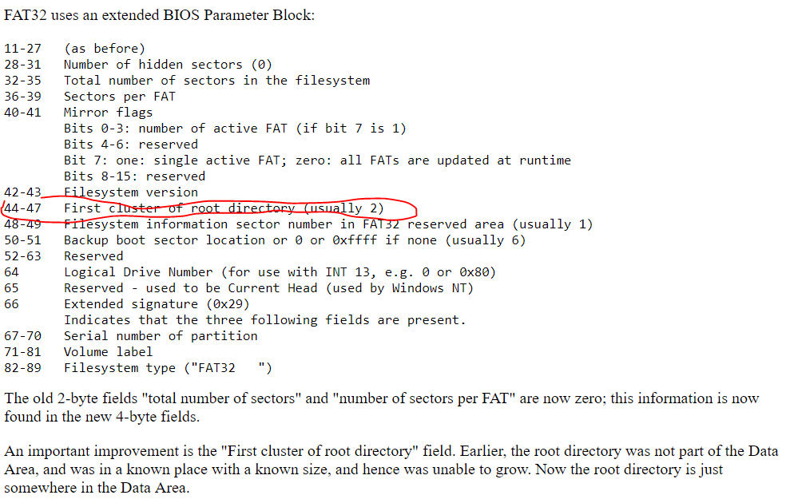
This field is only defined for FAT32 media and does not exist on FAT12 and FAT16 media. This is set to the cluster number of the first cluster of the root directory, usually 2 but not required to be 2. NOTE: Disk utilities that change the location of the root directory should make every effort to place the first cluster of the root directory in the first non-bad cluster on the drive (i.e., in cluster 2, unless it’s marked bad). This is specified so that disk repair utilities can easily find the root directory if this field accidentally gets zeroed.

Slide 17
http://www.cs.fsu.edu/~cop4610t/assignments/project3/spec/fatspec.pdf

Slide 18
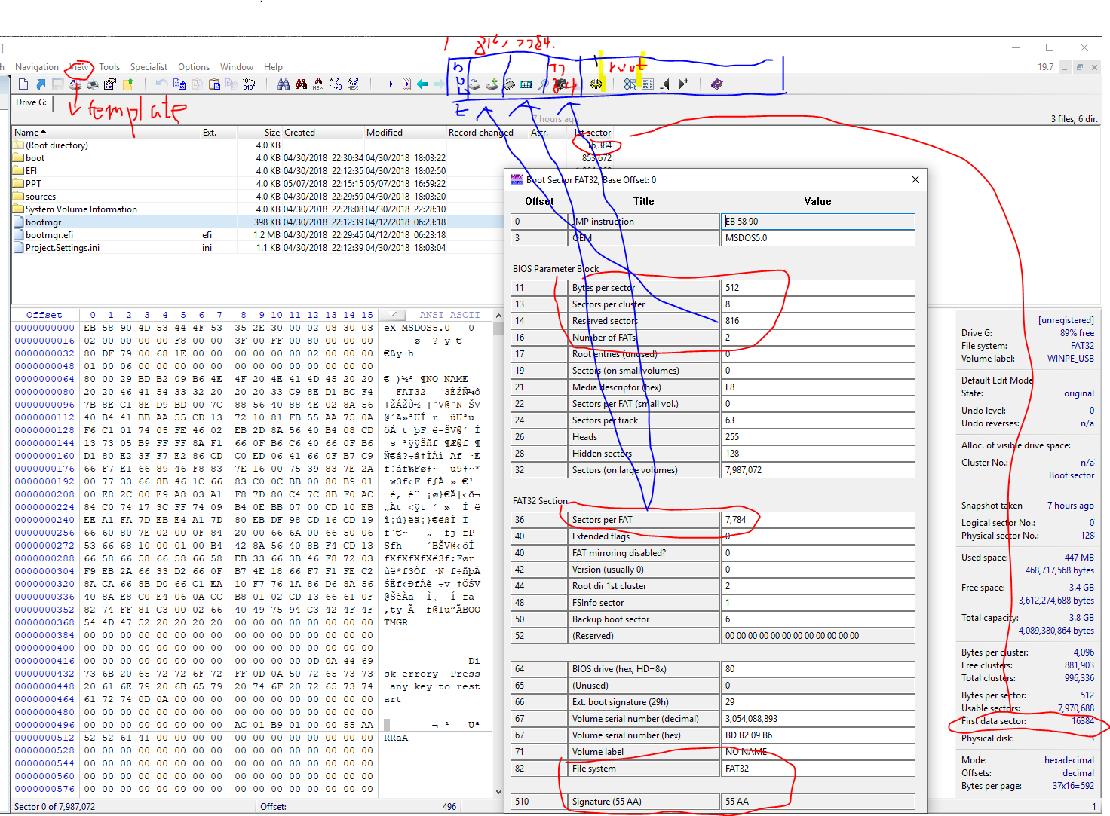

Slide 19
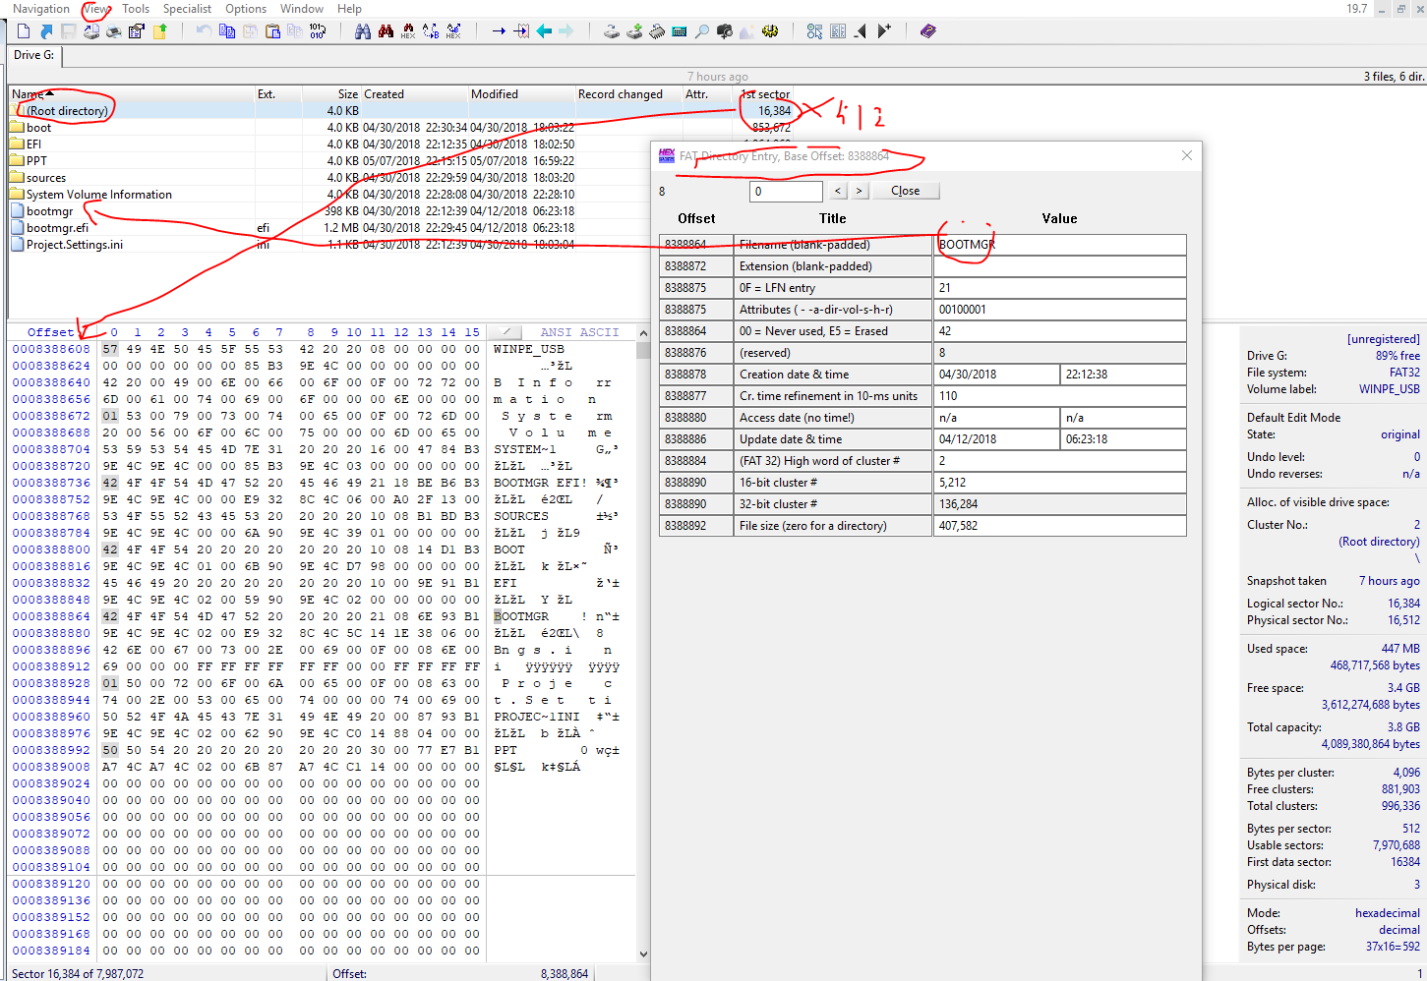

Slide 21
The File Allocation Table (FAT)
The table is a chart of numbers that correspond to cluster addresses on the hard drive.
Multiple FATs are used particularly on floppy disks
If the FAT is unreadable, files cannot be accessed and another copy of the FAT must be used.
On hard disks, there is often only one FAT.
In the case of the 16-bit FAT file system, each entry in the FAT is two bytes in length (i.e. 16 bits).

Slide 22
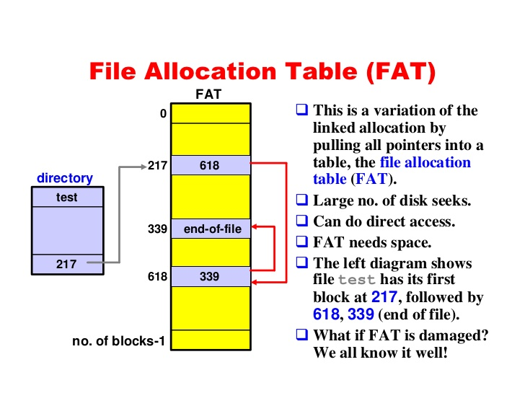

Slide 23
FAT Types
FAT8
The oldest FAT, FAT8 was used on 8-inch floppies with the 8086 processor.
FAT12
A File Allocation Table that uses 12-bit binary system that was derived from FAT8.
A hard drive formatted using FAT12 can use a maximum of approximately 16,736,256 volume size, and today is no longer used.
If your computer is running Windows 95 or above and your FAT within FDISK is being displayed as FAT12 your hard drive is corrupted, bad, or has a computer virus.
FAT32
Enhanced File Allocation Table utilizing a 28-bit binary system,
first used in Windows 95 OSR2 and Windows 98,
saves disk space by using 4 k Cluster
Later versions of Microsoft Windows, such as Windows XP, Vista, 7, and 10 are using NTFS and not FAT.
offers better methods of data protection and file recovery than the previous FAT file system versions.

Slide 24
The Root Directory
The root directory contains an entry for each file whose name appears at the root (the top level) of the file system.
Other directories can appear within the root directory;
they are called subdirectories.
The main difference between the two
space for the root directory is allocated statically, when the disk is formatted;
there is a finite upper limit on the number of files that can appear in the root directory.
Each entry is 32 bytes (0x20) in size
a single block can contain 16 of them (=512/32).

Slide 25
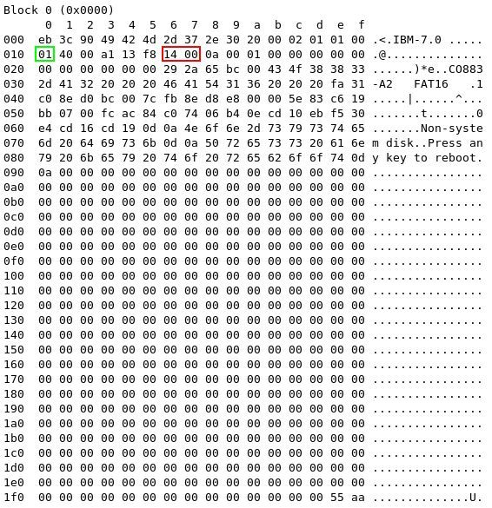
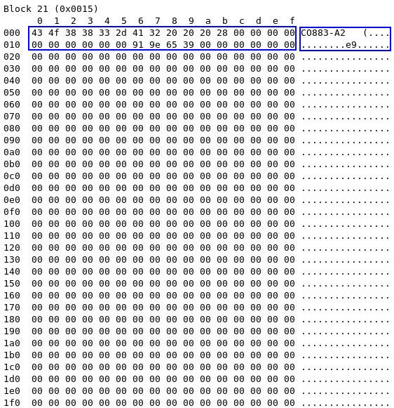
Example - find the root directory
Boot sector (1 sector) | FAT #1 (one+ sectors) | FAT #2 (one+ sectors+# FAT#1) | Root directory (FAT12/16 only) | Data region (rest of disk)
(size of FAT)*(number of FATs) + 1 boot sector
0x0014*1 + 1 => 0x0015 (decimal 21):
Note the # FAT is one (no second FAT in the example)
root directory in block 0x15

Slide 26
Example - find the root directory (FAT32)
FirstSectorofCluster = ((N – 2) * BPB_SecPerClus) +FirstDataSector;
FirstDataSector = Reserved Sectors + FAT Sectors + Root Sectors

Slide 27
A single Entry in the Root Directory (32 bytes=(20)hex)
Offset | Length | Description
0x00 | 8 bytes | Filename
0x08 | 3 bytes | Filename extension
0x0b | 1 byte | File attributes
0x0c | 10 bytes | Reserved
0x16 | 2 bytes | Time created or last updated
0x18 | 2 bytes | Date created or last updated
0x1a | 2 bytes | Starting cluster number for file
0x1c | 4 bytes | File size in bytes

Slide 28
Example: find the file name of a file
Scenario
FOOBAR.TXT has been created
It appears in the root directory
Goal
Find out which attribute flags are set on the file.

Slide 29
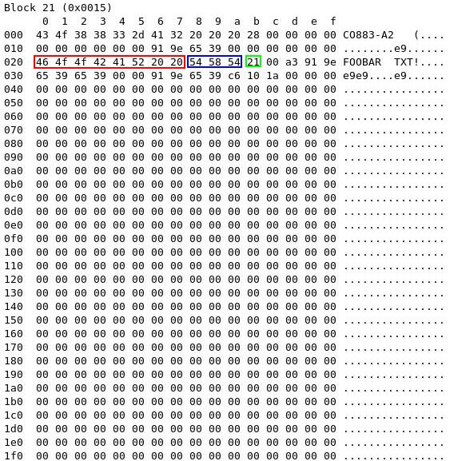
Offset | Length | Description
0x00 | 8 bytes | Filename
0x08 | 3 bytes | Filename extension
0x0b | 1 byte | File attributes
0x0c | 10 bytes | Reserved
0x16 | 2 bytes | Time created or last updated
0x18 | 2 bytes | Date created or last updated
0x1a | 2 bytes | Starting cluster number for file
0x1c | 4 bytes | File size in bytes

Slide 30
Example: find the attribute of a file
0x21=0x20+0x1
(read-only and archived file)
Offset | Length | Description
0x00 | 8 bytes | Filename
0x08 | 3 bytes | Filename extension
0x0b | 1 byte | File attributes
0x0c | 10 bytes | Reserved
0x16 | 2 bytes | Time created or last updated
0x18 | 2 bytes | Date created or last updated
0x1a | 2 bytes | Starting cluster number for file
0x1c | 4 bytes | File size in bytes
0x01 : Indicates that the file is read only.
0x02: Indicates a hidden file. Such files can be displayed if it is really required.
0x04: Indicates a system file. These are hidden as well.
0x08: Indicates a special entry containing the disk's volume label, instead of describing a file. This kind of entry appears only in the root directory.
0x10: The entry describes a subdirectory.
0x20: This is the archive flag. This can be set and cleared by the programmer or user, but is always set when the file is modified. It is used by backup programs.
0x40: Not used; must be set to 0.
0x80: Not used; must be set to 0.
0x80 | 0x40 | 0x20 | 0x10 | 0x08 | 0x04 | 0x02 | 0x01

Slide 31
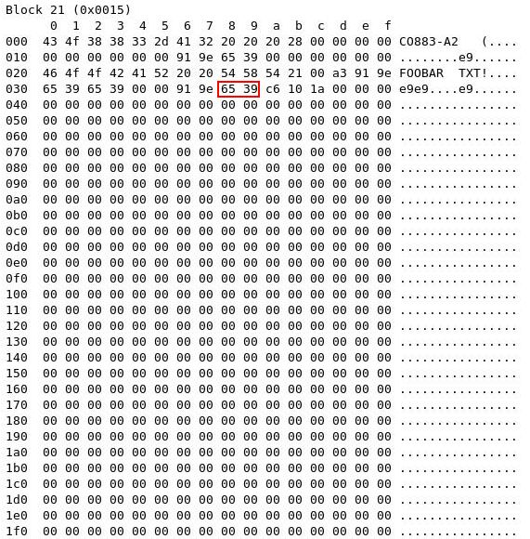
Example: find the date of a file
Offset | Length | Description
0x00 | 8 bytes | Filename
0x08 | 3 bytes | Filename extension
0x0b | 1 byte | File attributes
0x0c | 10 bytes | Reserved
0x16 | 2 bytes | Time created or last updated
0x18 | 2 bytes | Date created or last updated
0x1a | 2 bytes | Starting cluster number for file
0x1c | 4 bytes | File size in bytes
3 9 6 5
| | | |
V V V V
0 0 1 1 1 0 0 ,1 0 1 1, 0 0 1 0 1
28 11 5
(year) (month) (day)
Year: 1980+28

Slide 32
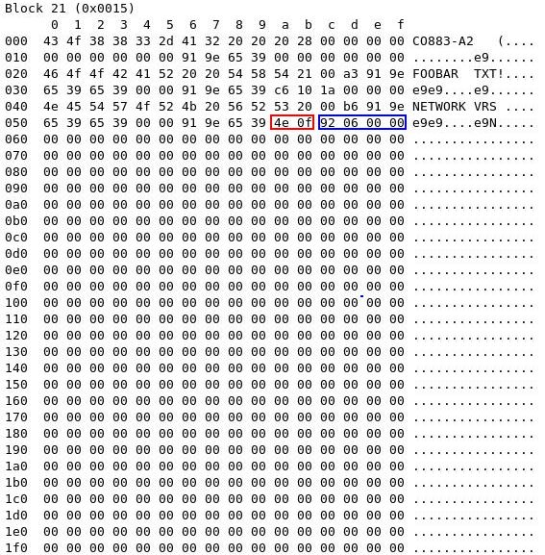
Example: find the start cluster # for a file NETWORK.VRS
Offset | Length | Description
0x00 | 8 bytes | Filename
0x08 | 3 bytes | Filename extension
0x0b | 1 byte | File attributes
0x0c | 10 bytes | Reserved
0x16 | 2 bytes | Time created or last updated
0x18 | 2 bytes | Date created or last updated
0x1a | 2 bytes | Starting cluster number for file
0x1c | 4 bytes | File size in bytes
(0x0f4e)hex
Cluster size =sector size in FAT 16
The start cluster # is an offset value in data region.
To compute the address of the data, we need to an abstract address

Slide 33
Example: find the file size NETWORK.VRS
Offset | Length | Description
0x00 | 8 bytes | Filename
0x08 | 3 bytes | Filename extension
0x0b | 1 byte | File attributes
0x0c | 10 bytes | Reserved
0x16 | 2 bytes | Time created or last updated
0x18 | 2 bytes | Date created or last updated
0x1a | 2 bytes | Starting cluster number for file
0x1c | 4 bytes | File size in bytes
(0x00000692)hex=(1682)decimal

Slide 34
Recall- find the root directory
Boot sector (1 sector) | FAT #1 (one+ sectors) | FAT #2 (one+ sectors) | Root directory (FAT12/16 only) | Data region (rest of disk)
0x15
(size of FAT)*(number of FATs) + 1 boot sector
0x0014*1 + 1 => 0x0015 (decimal 21):
Note the # FAT is one (no second FAT in the example)
root directory in block 0x15

Slide 35
How to find the end of the root directory
Boot sector (1 sector) | FAT #1 (one+ sectors) | FAT #2 (one+ sectors) | Root directory (FAT12/16 only) | Data region (rest of disk)
0x15
(size of FAT)*(number of FATs) + 1 boot sector
0x0014*1 + 1 => 0x0015 (decimal 21):
Note the # FAT is one (no second FAT in the example)
root directory in block 0x15
What is the end of the root directory?
Size of Root directory= # of entry
=0x0040*32 bytes
=4 sectors
So, the end of the root directory=0x0015+4
=0x0019

Slide 36
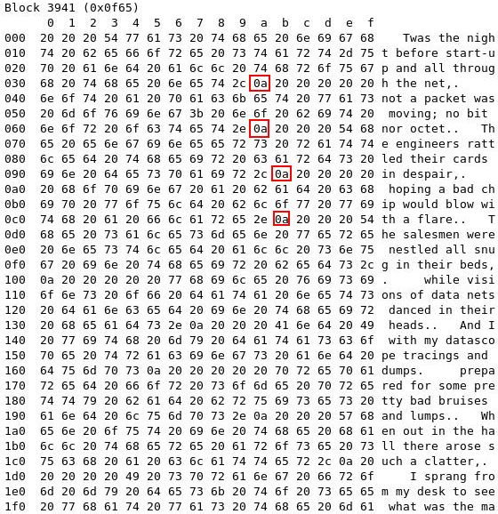
The sector # for file NETWORK.VRS
Covert from logic address (cluster #) to physical address (sector #)
0x19-2+0xf4e (Cluster offset in data region) =0xf65 (sector/block#)
The Starting Cluster Number
The first cluster for data space on the disk is always numbered as 0x0002. This strange arrangement is because the first two entries in the FAT are reserved for other purposes.

Slide 37
512Bypes for each sector
Sector 0 | Sector 1.. | Sector 14 | Sector 0x15 | Sector . | Sector . | Sector . | Sector 0x19 | … | Sector N
 |  |  |  |  |  |  | Cluster 2 |  | Cluster
Boot | FAT |  | Boot Directory |  |  |  | Data Region
 |  |  | NETWORK.VRS start cluster 0xf4e
Cluster# | Next Cluster#
 | 8bits | 8 bits
0 | media descriptor | 0xff
1 | 0xff | 0xff
2
0xf4e | ? | ?
#cluster-1
Entry 0 and 1 for different purposes
Size= 0xf4e(# of entries)*2 bytes (size of entry)=0x1e9c
0x1e9c = 0x0f (# of sectors) + 0x9c (offset) // how to compute these numbers?
The absolute address of the entry 0xf4e in the USB
= (0x0f+1) sectors and 0x9c offset where 1 is the sector 0
Shown in next slide

Slide 38
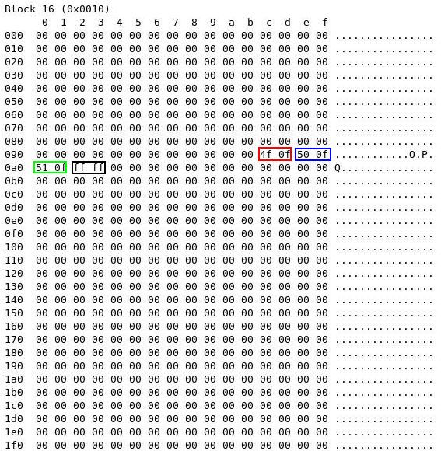
(0x0f+1)
0x9c offset
See next->
0x0f4f (cluster#)+0x17=0x66
Where 0x17 comes from?
Next cluster
Cluster# | Next Cluster#
 | 8bits | 8 bits
0 | media descriptor | 0xff
1 | 0xff | 0xff
2
0xf4e | ?4f | ?0f
#cluster-1

Slide 39
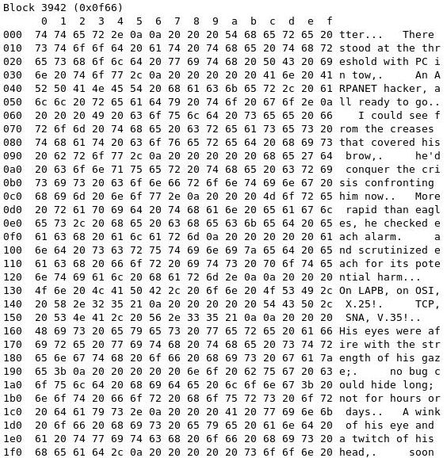
Cluster# | Next Cluster#
 | 8bits | 8 bits
0 | media descriptor | 0xff
1 | 0xff | 0xff
2
0xf4e | 4f | 0f
0x0f4f | ? | ?
#cluster-1

Slide 40
Cluster# | Next Cluster#
 | 8bits | 8 bits
0 | media descriptor | 0xff
1 | 0xff | 0xff
2
0xf4e | 4f | 0f
0x0fef | 50 | 0f
#cluster-1
(0x0f50)cluster-> (0x0f50+17)sector
=0xf67---→next slide

Slide 41
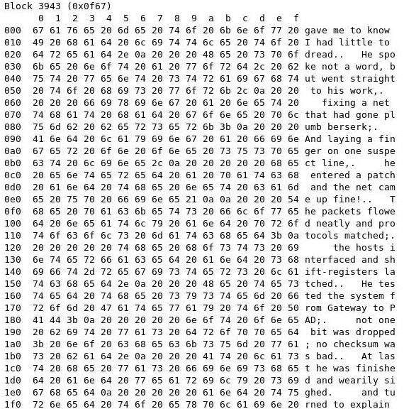

Slide 42
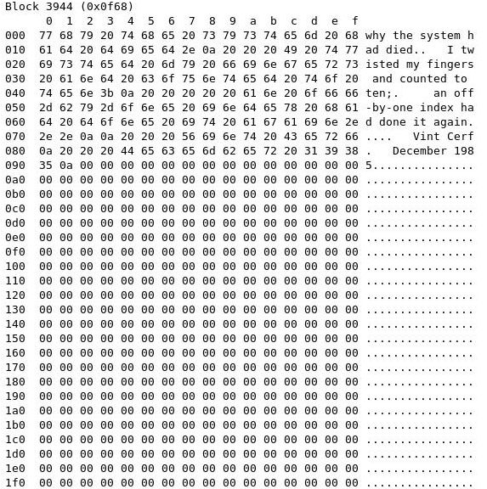

Slide 43
Cluster# | Next Cluster#
 | 8bits | 8 bits
0 | media descriptor | 0xff
1 | 0xff | 0xff
2
0xf4e | 4f | 0f
0x0f4f | 50 | 0f
0x0f50 | 51 | 0f
0x0f51 | ff | ff
#cluster-1

Slide 44
Conclusion
If you've managed to get this far (and understood it all) you have a good working understanding of the 16-bit FAT file system.
You should be able to analyse a disk, and see if it is corrupted. You may even be able to repair it!

Slide 45
Tip: Convert 0x1e9c to sectors and offset
We know that one disk block (and thus one block of the FAT) is 0x200 bytes in size, so we just need to divide 0x1e9c by 0x200. This sounds hard, but it isn't. You can find tools for this, or do it yourself. Let's look at these two numbers in binary:
0x0200 => 0 0 0 0 0 0 1 0 0 0 0 0 0 0 0 0
0x1e9c => 0 0 0 1 1 1 1 0 1 0 0 1 1 1 0 0
The first number is a power of two, so to divide by it we simply shift the second number right - in this case by nine places:
0 0 0 0 0 0 0 0 0 0 0 0 1 1 1 1 => 0x0f
So the entry we want is in block 0x0f of the FAT. The remainder from our division is of course all the bits we lost when we shifted:
0 1 0 0 1 1 1 0 0 => 0x9c
so this is the byte offset of the entry within the FAT block.

Slide 46
reference
http://www.dewassoc.com/kbase/hard_drives/boot_sector.htm
http://www.tavi.co.uk/phobos/fat.html
https://www.compuphase.com/mbr_fat.htm
http://www.cse.scu.edu/~tschwarz/COEN252_09/Lectures/FatExample.html
http://havefunwhileulearn.blogspot.com/2010/05/dissecting-fat-16-file-system.html

